Slide 1



Credit Card Insights for Mitron Bank
Atliq Data Services

Slide 2



Project analysis slide 3
Introduction
Mitron Bank is a legacy financial institution headquartered in Hyderabad. They want to introduce a new line of credit cards, aiming to broaden its product offerings and reach in the financial market.
Mr. Bashnir Rover Strategy Director of Mitron Bank, asked us to do a pilot project with the sample dataset of 4000 customers across five cities on their online spend and other details.
This analysis is expected to guide them in tailoring the credit cards to customer needs and market trends.

Slide 3
Project analysis slide 4
Datasets
Customers
Spends
Age Group
Category
Avg Income
Month
City
Payment Type
Cust_ID
Cust_ID
Gender
Marital Status
Occupation

Slide 4
Project analysis slide 2
Insights covered
Market Potential
Category specific Spendings
Demographic Targeting
Age Group Preferences
Seasonal Spending Trends
Geographical Hotspots

Slide 5
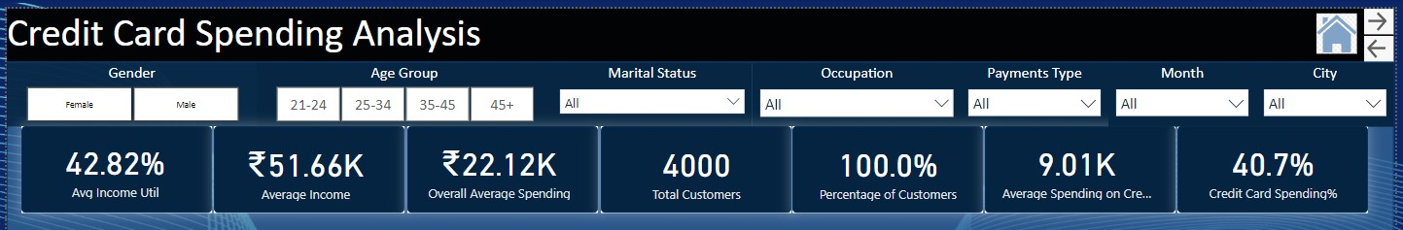
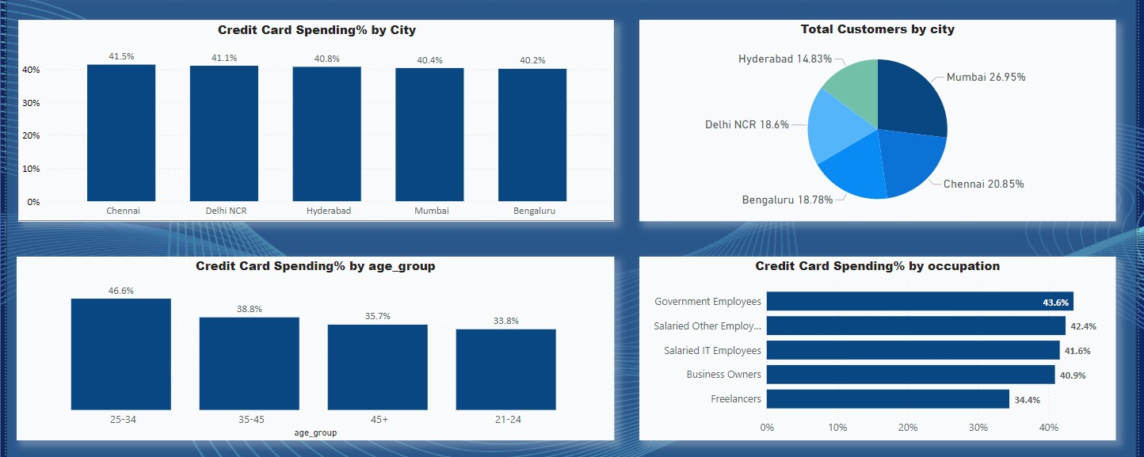
Project analysis slide 10
Insights
Market Potential:
What is the overall Market Potential for Credit card Usage based on the distribution of customers across cities?
As per the analysis Mitron Bank Customers use credit card for 40.7% of their average spendings.
Cities like Chennai, Delhi and Hyderabad have high Credit card spending% (>40.7%)
However the overall distribution of the customers is less in Hyderabad and Delhi.- We should consider high Credit card spending% as an opportunity for increasing the market in these cities.
Recommendations:
We need to design and implement marketing campaigns tailored to the specific needs and preferences of the local population in Hyderabad and Delhi.

Slide 6

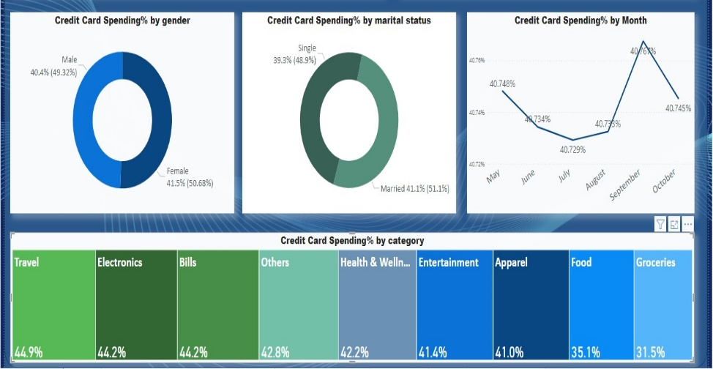
Project analysis slide 10
Insights
Demographic Targeting:
Which Demographic segments(Marital Status, Profession, Gender, Age Group) show the highest credit card adoption rate?
Compared to overall Credit card spending%(40.7%), Below Segments has higher rate of usage.
Age Group- 25-34 (46.6%)
Profession:
Govt Employees(43.6%)
Salaried Other(42.4%)
Salaried IT(41.6%)
Business Owners(40.9%)
Gender- Female (41.5%)
Marital Status- Married(41.1%)
Recommendations:
The customers from above Demographical segments are the core users of our credit card. We can offer loyalty programs or additional benefits to retain valuable customers.

Slide 7
Project analysis slide 10
Insights
Seasonal Spending Trends
Are there specific months with increased credit card spending?
Compared to Overall Credit card Spending%(40.7%)
Credit card Spending% of customers is high in September followed by May, October and June.
Recommendations:
The Bank must consider collaborating with top merchants from categories like Travel, Bills, Electronics, Others, Health& Wellness and create exclusive offers or discounts for customers using the new credit card to increase Credit card spending.

Slide 8
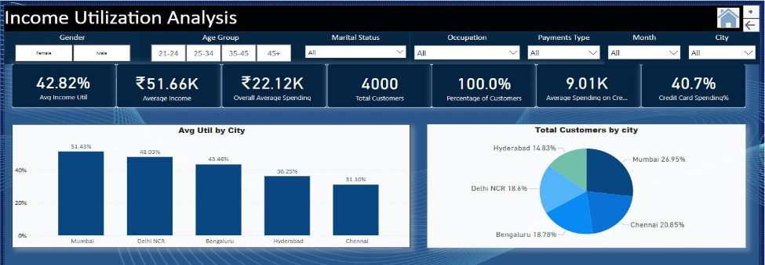

Project analysis slide 10
Insights
Geographical Hotspots
Which cities demonstrate the highest spending pattern, indicating potential areas for targeted marketing and expansion?
As per the analysis Mitron Bank Customers Average Income Utilization= 42.82% (Avg. Income Utilization = Avg. Spending / Avg. Income)
Below Cities have highest Avg Income Util%
Mumbai-51.43%
Delhi-48.03%
Bengaluru-43.46%
Recommendations:
Introduce Targeted Reward Programs for spendings made on credit card for Categories: Bills, Electronics, Groceries, Health&Wellness Travel.
We need to design and implement marketing campaigns tailored to the specific needs and preferences of the local population in Bangalore and Delhi as overall distribution of the customers is less in Delhi and Bangalore.

Slide 9
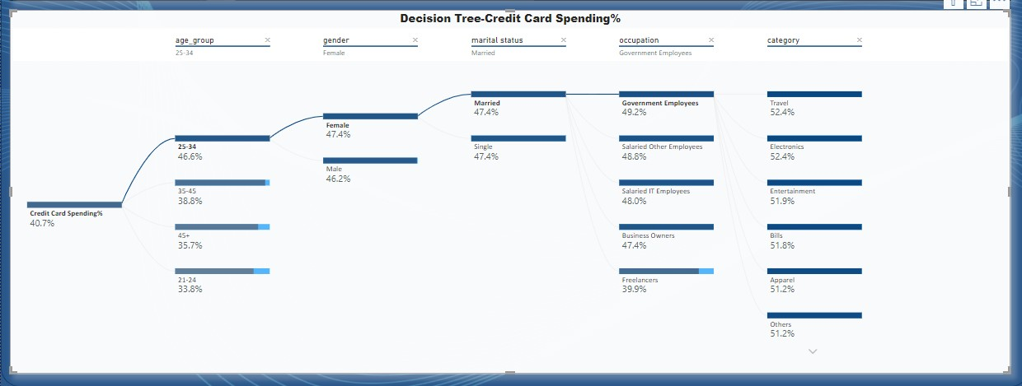
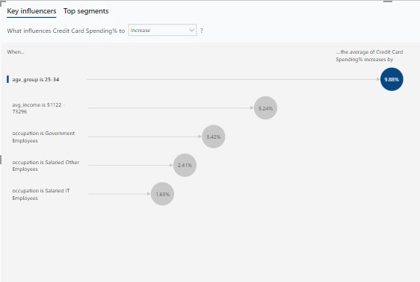
Project analysis slide 10
Insights
Age group Preferences:
Which Age groups are more inclined to use credit cards, and how can marketing strategies be tailored to address specific age demographics?
When Age Group is 25-34, The Average Credit card Spending% increases by 9.88%
Recommendations: Special Promotions and Offers, Tailor Rewards to Top Categories, Forge Exclusive Merchant Partnerships should be followed to increase credit card usage in this age group.

Slide 10
Project analysis slide 10
Insights
Category-Specific Spendings:
What are the most popular spending categories among credit card users, and how can partnerships or rewards be optimized for these categories?
Travel, Electronics, Bills, Others, Health& Wellness, Entertainment- These categories are most popular among the credit card users.
Recommendations:
Customize credit card rewards to provide enhanced benefits for top spending categories
Implement a tiered rewards system based on spending levels and encourage customers to reach higher tiers by spending more, unlocking additional benefits.
Send targeted promotions based on individual spending habits and preferences.

Slide 11
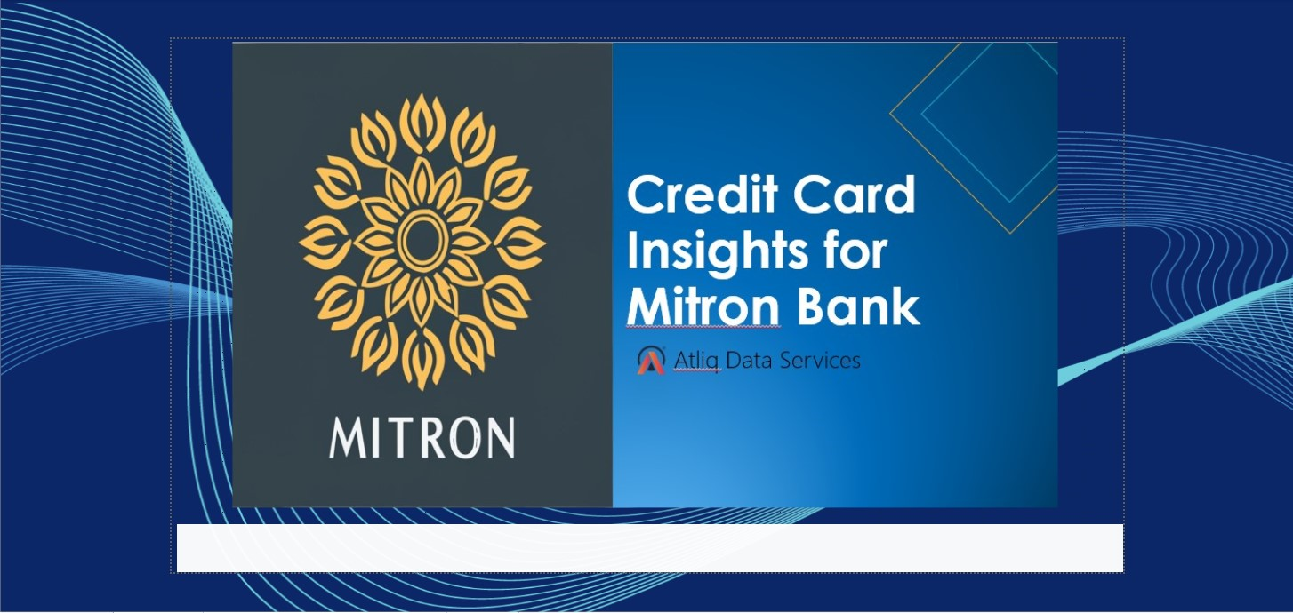
Project analysis slide 4
Snapshots of the Dashboard

Slide 12
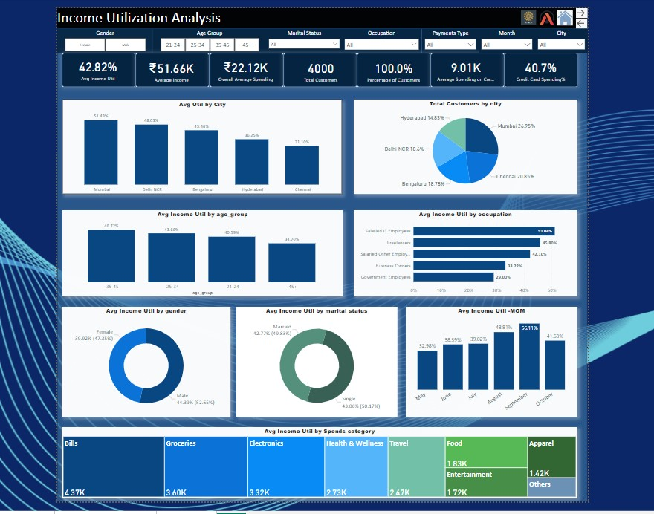
Project analysis slide 4
Snapshots of the Dashboard

Slide 13
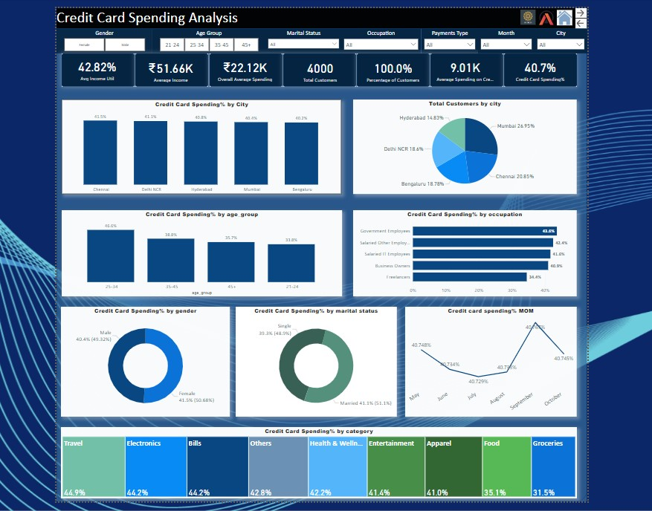
Project analysis slide 4
Snapshots of the Dashboard

Slide 14
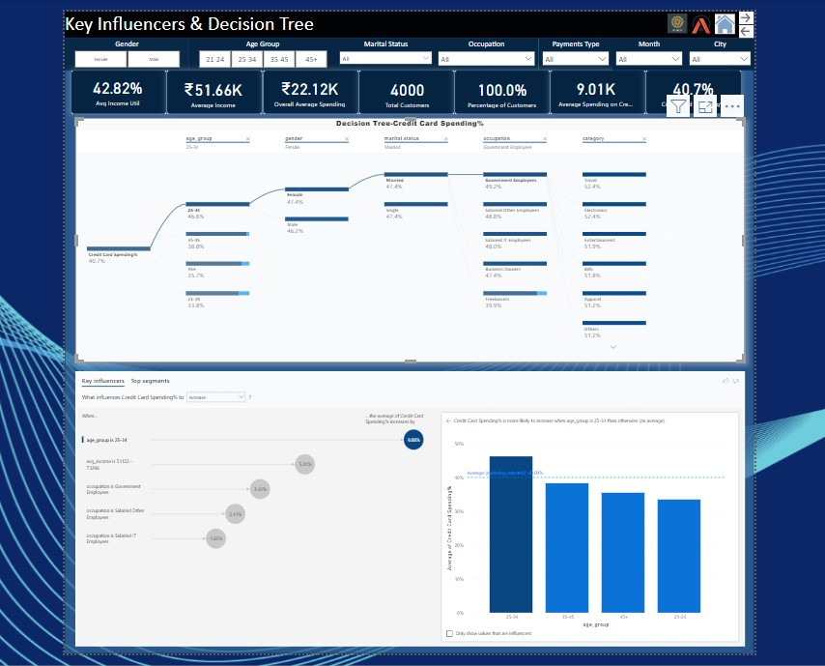
Project analysis slide 4
Snapshots of the Dashboard

Slide 15

Thank You
Arun Kumar M

